Slide 1
A new restaurant in Birmingham, UK
Finding the popular cuisines and best neighbourhoods

Slide 2
A new restaurant in Birmingham, UK
An investor located in Birmingham is currently interest in adding a restaurant to his assets list. He is aware of a few entrepreneurs looking to open new restaurants in his area, and in order to support his choice in choosing the right project, he would like to know:
What cuisines he should look into investing
What neighbourhood would be the best to open a new restaurant
The investor is looking to invest in an area that is growing, therefore, we will avoid the most popular neighbourhoods in the city.

Slide 3
Data
List of neighbourhoods in Birmingham from Wikipedia: Data scraped from Wikipedia and stored in a a .CSV file
Foursquare API: The API was used to collect information of food venues in a radius of 500 metres from the centre of each neighbourhood.
The data was then used to define the most popular cuisines in Birmingham and also to help identify the best neighbourhood to open a restaurant.

Slide 4
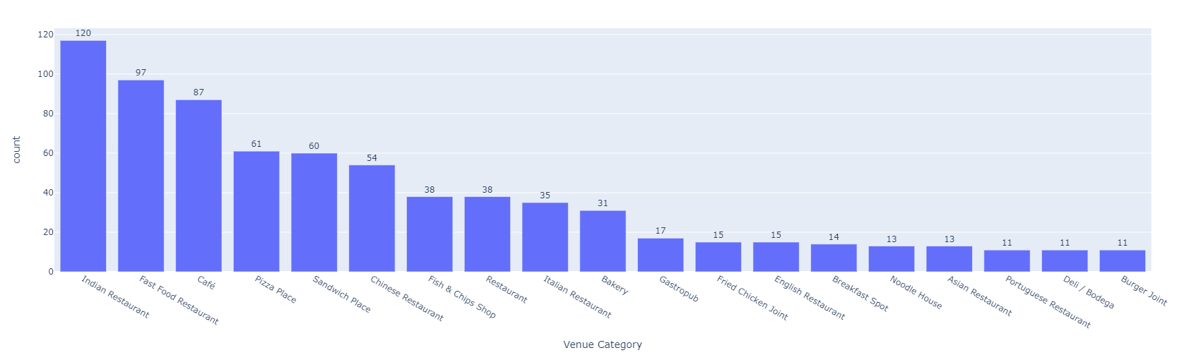
Most popular cuisine

Slide 5
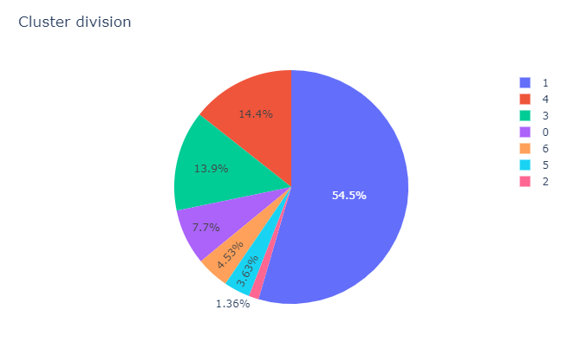
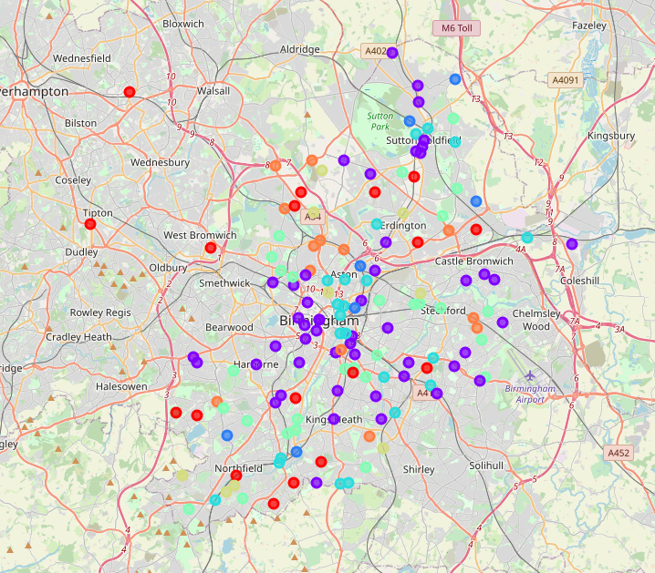
Clusters

Slide 6
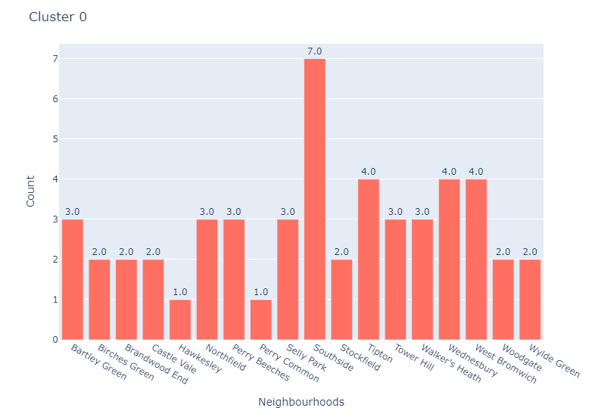
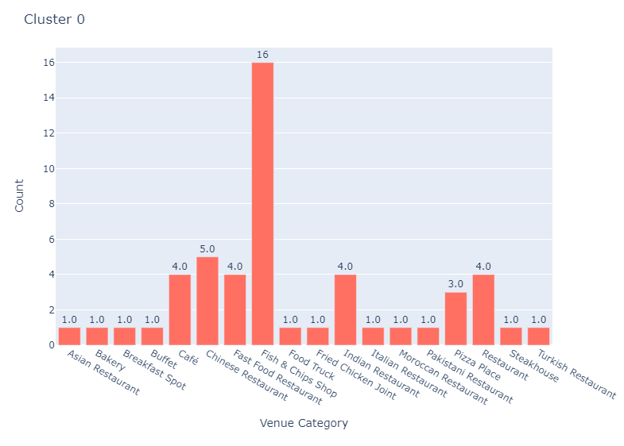
Cluster 0
This cluster has a good variety of cuisines with an average of 2.8 restaurants per neighbourhood. It has a good amount of Chinese and Indian restaurants, but no Italian restaurant.

Slide 7
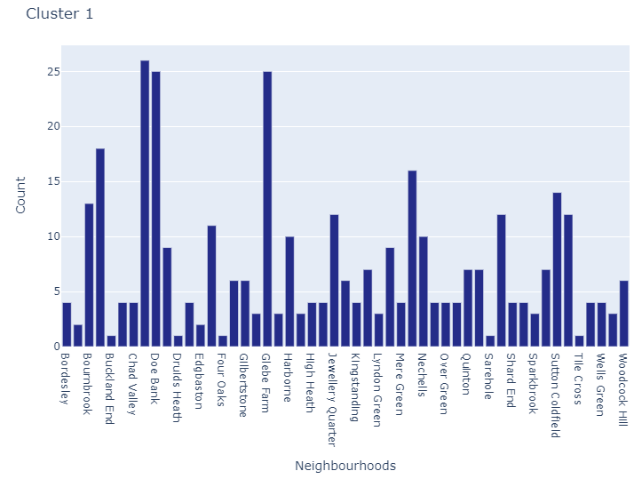
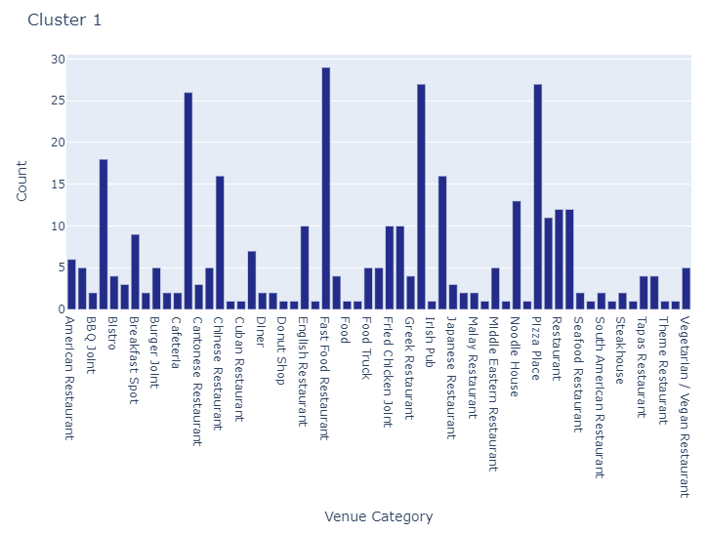
Cluster 1
This cluster has the biggest amount of neighbourhoods and venues and we can conclude those are the busiest neighbourhoods, so if an investor wants to open a restaurant in a well stabilised gourmet area, he should probably explore the neighbourhoods in this area.

Slide 8
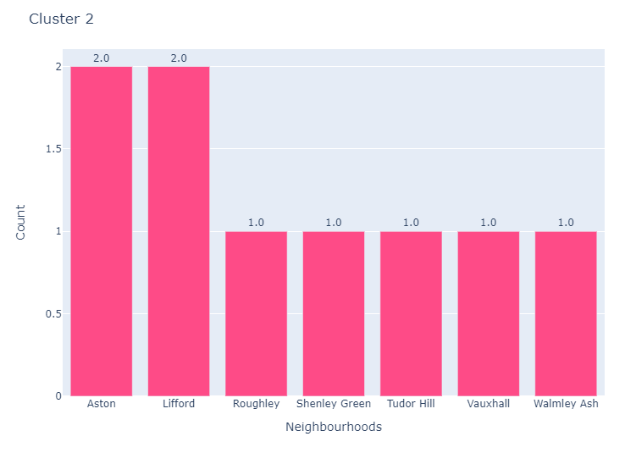
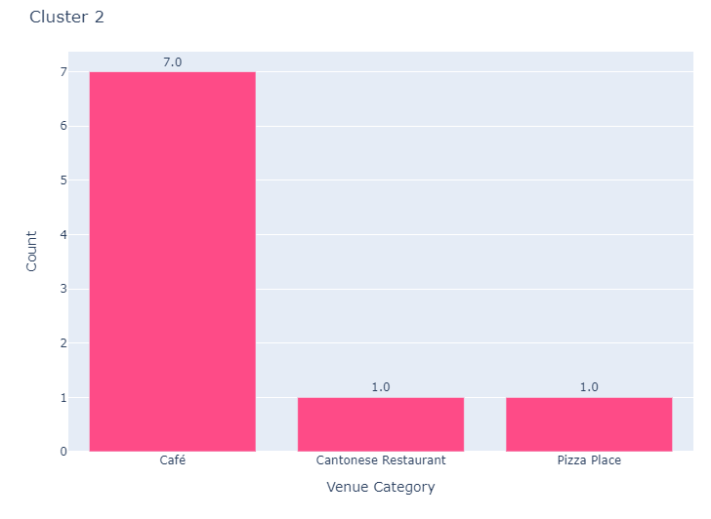
Cluster 2
This cluster has the neighbourhoods with the less amount of venues and the lowest diversity of venues, so it is probably not a very popular area for eating out.

Slide 9
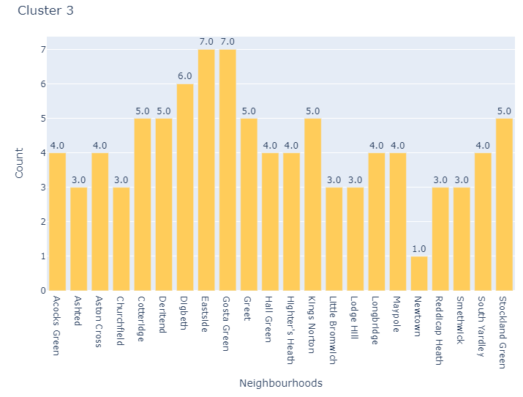
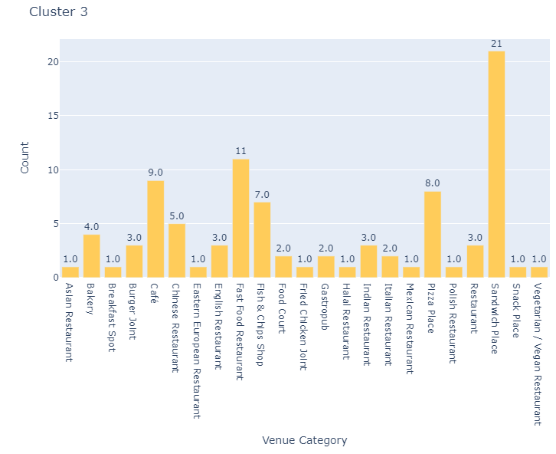
Cluster 3
The cluster 3 seems to have the neighbourhoods with an average of 4.1 restaurants per neighbourhood and with a good diversity of cuisines.

Slide 10
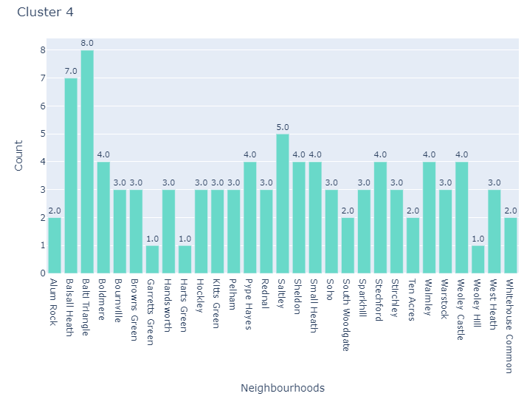
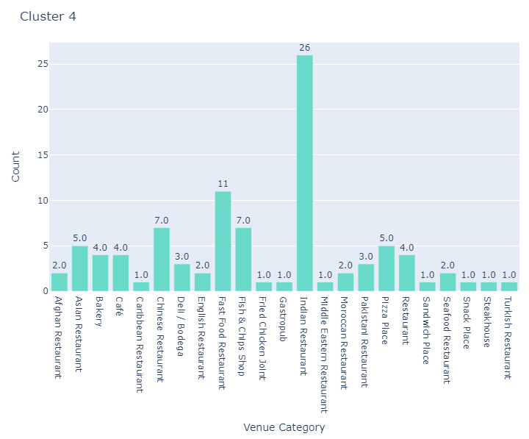
Cluster 4
This cluster seems to have the biggest concentration of Indian restaurants and with a good diversity of restaurants, but it has no Italian restaurant.

Slide 11
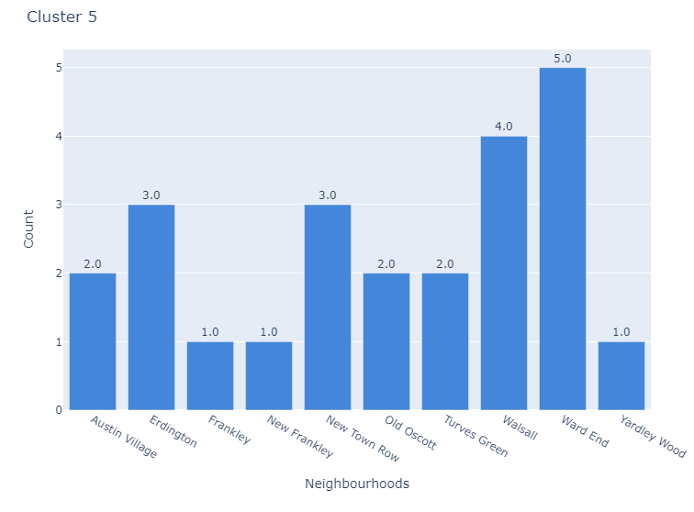
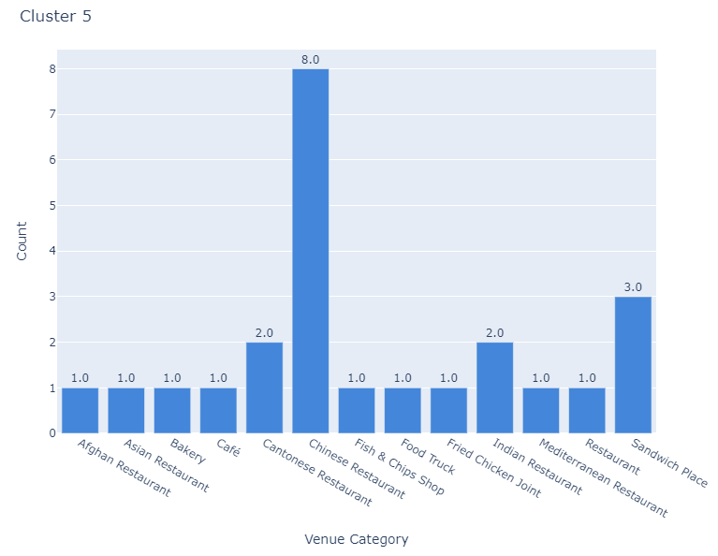
Cluster 5
This cluster has the biggest concentration of Chinese restaurants and again no Italian restaurant and an average of 2.4 restaurants per neighbourhood.

Slide 12
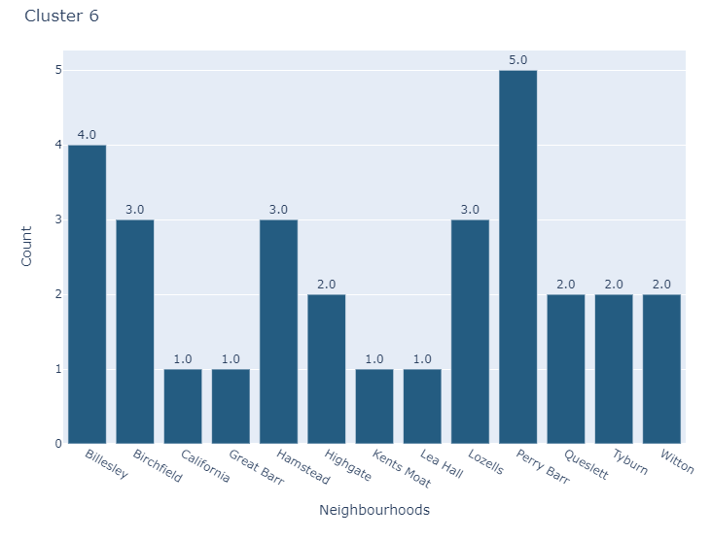
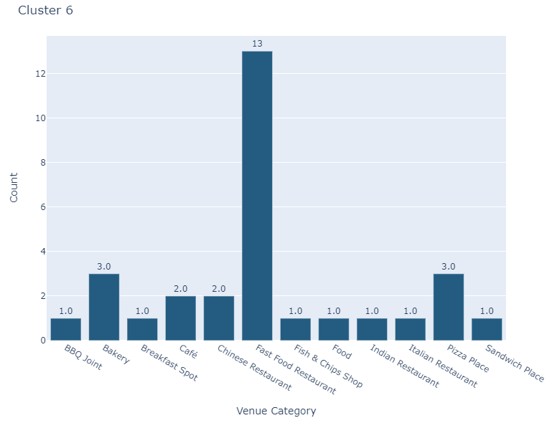
Cluster 6
This cluster has the biggest amount of fast food restaurants, which may indicate that people in this area are not very keen to go to restaurants for meals as a leisure activity.

Slide 13
Discussion and recommendations
Taking in consideration that:
The most popular cuisines in Birmingham are Indian, Chinese and Italian, being Italian the type of cuisine with the lowest amount of venues
The clusters 4 and 5 gather the neighbourhoods with a good average of restaurants and a good diversity of venue categories
The recommendation for the investor is to open an Italian restaurant. If the goal is to explore neighbourhoods where there is not much competition, I would recommend the neighbourhoods in the cluster 4 and 5, where the most popular neighbourhoods for restaurants are Ten Acres, Boldmere, Walsall and Erdington.

Slide 14
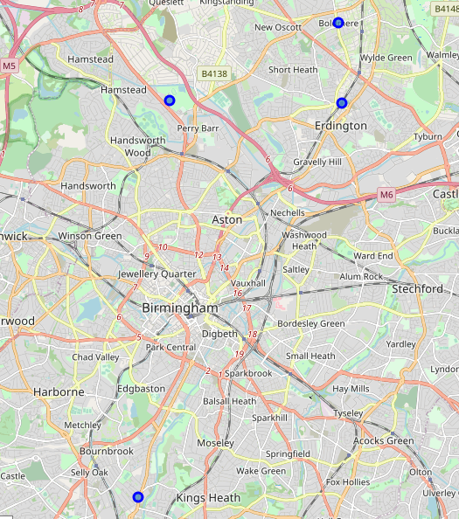
Recommended neighbourhoods

Slide 15
Conclusion
Birmingham is a very diversity city with a good amount of restaurants, and even though the most popular cuisine is Indian, there are many cuisines to explore in the area from different areas of Europe, Asia and even America.
Using the Foursquare API and machine learning to cluster the neighbourhoods allowed to provide insights on what are public preferences and also the best areas to invest.

